Slide 1
2016-2017 Leadership Academy
By: Franki-Marie Herdt
&
Mechelle Reeve

Slide 2
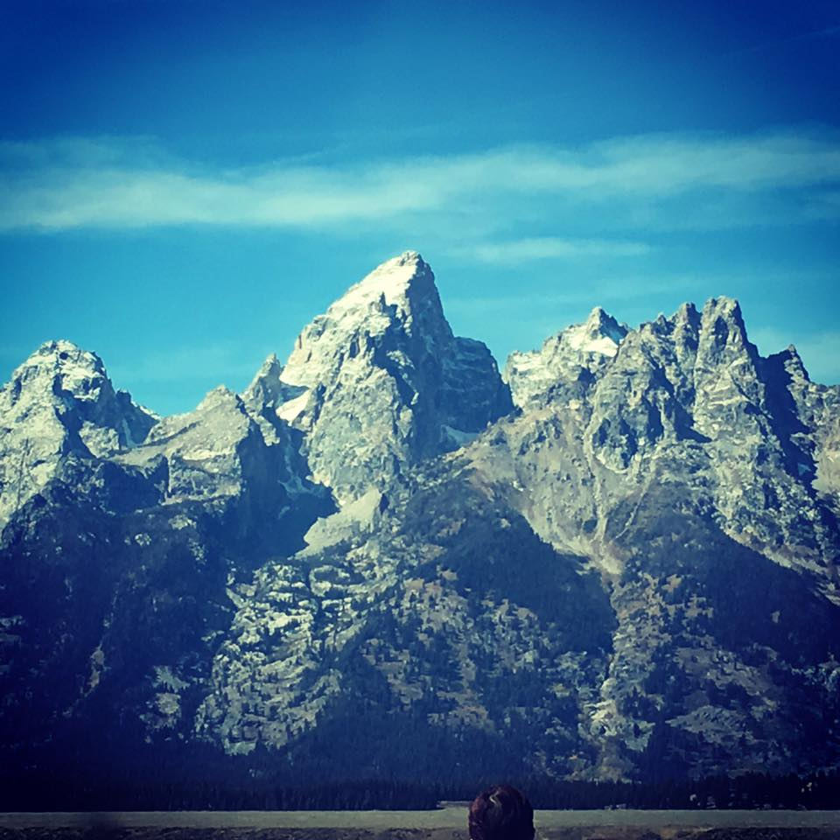
Our Leadership Journey
The Beginning of Something Great
Notes:
Franki: I never intended on applying for the leadership academy because I never considered myself a leader. I am usually a quiet and shy person that is usually content being a worker bee. Being a part of ASCLS made me realize that I could help my fellow coworkers and professionals by bringing my knowledge and experience to a leadership position within the society. Fran and Danielle from Wyoming informed be about the leadership academy and all the benefits they have gained through going through the program. After my own research, I realized this program could help me obtain my goals, not only with my job, but within the society.
Mechelle:

Slide 3
Our Leadership Journey
September 27-29th – Jackson, WY
Notes:
Franki: Living in Cheyenne, I drove myself to Jackson on that Monday (Sept 26th) to begin this fun journey! One of my favorite classes of the weekend was one talking about what kind of leader you are. I always assumed a leader was someone who always took action and was assertive. I was pleasantly surprised to learn that there are still good leaders in people like me!
Mechelle:

Slide 4
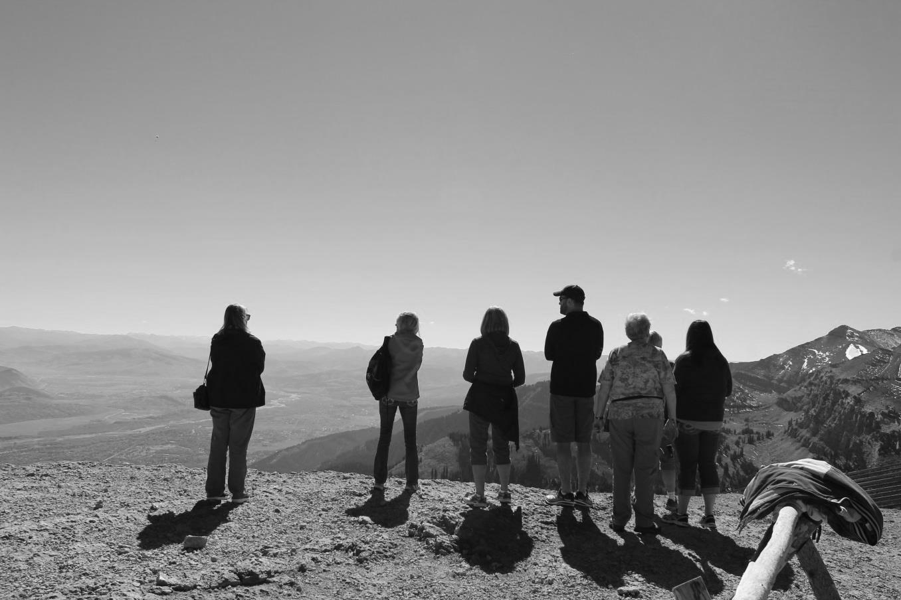
Our Leadership Journey
Many weekend/night meetings via GoToMeeting
Notes:
We met on Saturdays mornings and week nights in order to get all of the lectures completed. There were a couple of times we had to reschedule due to work schedules or family but we eventually completed them all! Thank you to the Leadership Academy instructors for being so flexible!

Slide 5
Leadership Academy 2017 Project
Retention and New Members
Montana Licensed Members | ASCLS Members
 | ASCLS Licensed Members | ASCLS Non-Licensed Members
717 | 75 | 39
Total Licensed | 717
ASCLS Members | 84
Licensed Non-members | 633
Notes:
Originally we wanted to work on ways to help market our profession. We soon realized how big of a task this was and decided to focus on retention and new members. Obviously there are a lot of different ways to help with retention and obtaining new members. Specifically for our states, we wanted to look at the raw numbers of members vs. nonmembers. We were able to obtain Montana’s list of registered MLT/MLS people because of their state licensure requirements. Obviously, we have a huge number of nonmembers. (633) This got us thinking why? Why WOULDN’T you want to be apart of your national society? Do they not know what we do?

Slide 6
Leadership Academy 2017 Project
Questions for Nonmembers:
Why are you not a part of ASCLS?
Are you a part of any national societies?
Do you know what ASCLS could do for you?
Questions for Members:
What caused you to lapse in membership?
Have you been in contact with your state society?
Did you feel pressured to be an active participant?
Notes:
We decided the best way to answer those questions is to ask those people directly. We came up with a list of questions to ask nonmembers. Some examples are:
Why are you not a part of ASCLS?
Are you a part of any national societies?
Do you know what ASCLS could do for you?
Etc.
Next, we started to think about retention and why we have people that no longer renew their memberships. We decided on a similar line of questioning. Some examples are:
What caused you to lapse in membership?
Have you been in contact with your state society?
Did you feel pressured to be an active participant?
We discussed the easiest ways to get these questions out to members and nonmembers. One suggestion was creating a postcard that could be filled up and simply mailed back. This way, it could be anonymous (if they were worried about being contacted again) and cheap for state societies. There are also many polling sites online that could be emailed to members (since we would have no way of accessing non member emails).

Slide 7
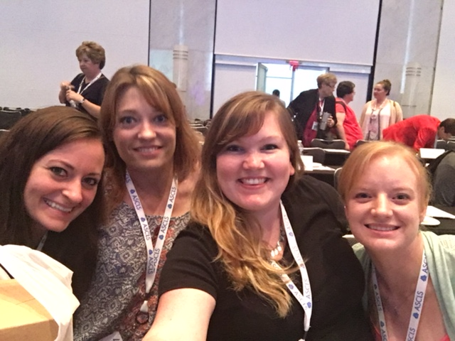
Leadership Academy 2017 Project
Ways to Market ASCLS to Coworkers
Within Workplace
Continuing Education
Legislation
Outside the Workplace
Networking
Friendship
Ways to Market ASCLS to Laboratory Managers
Legislation
Leadership Academy
Notes:
We then wanted to focus on what an everyday ASCLS member could do to help with recruitment. We came up with a document that helped give ways to market ASCLS to coworkers. This is someting that could be handed out by state leadership to fellow members to help with conversation starters at their jobs. The list includes benefits within the workplace as well as outside the workplace. A few of these examples include:
- Continuing education: Being a part of ASCLS gives you opportunities to attend conventions for State, Regional, and National meetings at a discounted rate.
More variety of continuing education (and live!) that can be directly applied to the work you are doing (i.e. new information about bacteria in Microbiology, etc.)
Can form a personal relationship with speaker in order to ask follow up questions at a later date, etc.
- Legislation
Being a member of ASCLS helps keep you in the know of legislative issues going on that can affect our profession.
Members go to Capitol Hill yearly to talk to our legislators to make them aware of the significance of issues and try to fight for issues affecting the lab (i.e. safety requirements, pay, work force shortages, CMS regulations, etc.)
Networking
Moving/Vacationing
Help with places to eat/visit
Places to live in a particular area
Local places worth seeing
Friendship
Groups of like-minded people doing things they all enjoy (i.e. museums, brewery, marathon, etc.)
We also created another document with ways to market to laboratory managers. This can be very important since they have such a big influence on the rest of the lab, whether that pertains to time off to attend conferences or reaching out to other labs to compare methods of patient care. Some of these include:
Legislation
Being a member of ASCLS helps keep you and your employees updated about legislative issues going on that can affect our profession.
Members go to Capitol Hill yearly to talk to our legislators to make them aware of the significance of issues and try to fight for issues affecting the lab (i.e. safety requirements, pay, work force shortages, CMS regulations, etc.)
Leadership Academy
Being a part of the Leadership Academy on the national level (or regional level if that region has a Leadership Academy) helps you and employees learn skills you need to become a leader in your laboratory and in the ASCLS society.
The skills help you and employees understand what kind of leader you are which allows you to use these skills in your everyday work.
It also helps employees learn skills to use in order to make for an overall better workplace (i.e. emotional intelligence, meeting planning, etc.).

Slide 8
Leadership Academy 2017 Project
College/Universities
Send information to MLS/MLT programs
Provide contact information
Ask if they would be willing to let someone from your state ASCLS society come and give a presentation
Follow up
Notes:
Lastly, we wanted to include students and new professionals. We wanted to create some material for universities/colleges that can inform students about the benefits of ASCLS. Upon further inspection, we discovered there are already documents on the ASCLS website for universities/colleges to use to inform their students. We realize they may not realize this information exists so they may not be seeking out these materials for their students. It is our job to make sure the programs in our states are kept up to date with all the latest material. We created a step by step to make sure the information gets to the right person at the college/university and that the instructor has contact information in case they (or the students) have further questions.
Send information to MLS/MLT programs in your state to help provide information to the instructors and students about ASCLS
Explain the benefits of ASCLS membership
Talk about the state, regional, and national convention meetings
Talk about the CE and networking benefits
Explain what ASCLS does on a national legislative level
Explain how they can get involved as an ASCLS member
Provide them with information and links to signing up for membership
Send new members a welcome packets (New member packets was a previous Region VIII Leadership Academy project)
Provide contact information
Ask if they would be willing to let someone from your state ASCLS society come and give a presentation about ASCLS and the value it is to our profession
Follow up a week or longer after to make sure they do not need any other information.

Slide 9
Leadership Academy 2017 Project
Tool Kit
Survey Questions
Ways to Market ASCLS to Coworkers
Ways to Market ASCLS to Laboratory Managers
College/University step by step
Notes:
After finishing all of these tasks, we realized we wouldn’t be able to complete all of these tasks for our individual states. We wanted to create a tool kit that state societies could use in order to make the process easier. Also, we thought this would be great information to add to the new member packet that the Leadership Academy has made in previous years. The Tool Kit will include Survey Questions, Ways to Market ASCLS to Coworkers, and College/University step by step.

Slide 10
Questions?

