Slide 1
The ASCLS website
One stop for all your professional needs
Learning about ASCLS
Volunteering
Events
Continuing Education
Member Communities
WWW.ASCLS.ORG

Slide 2


Slide 3
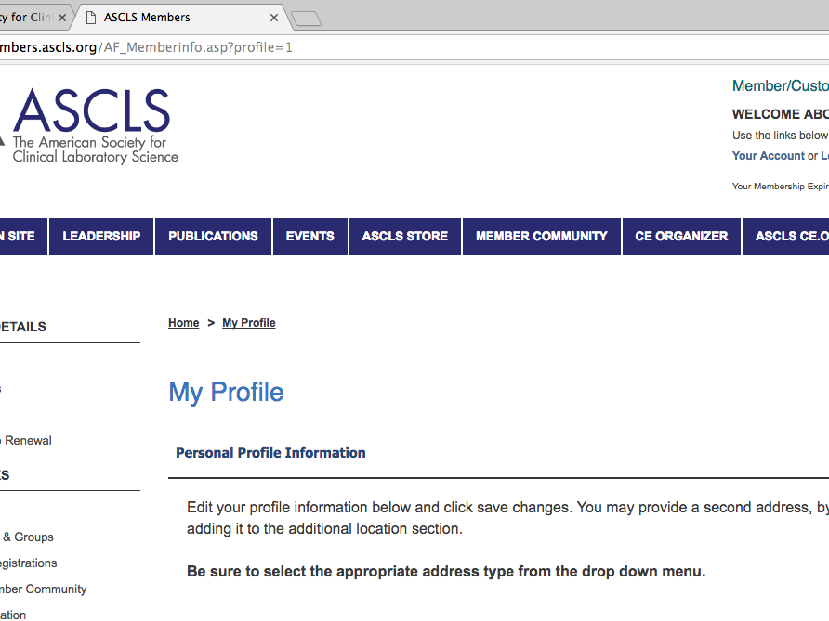

Slide 4
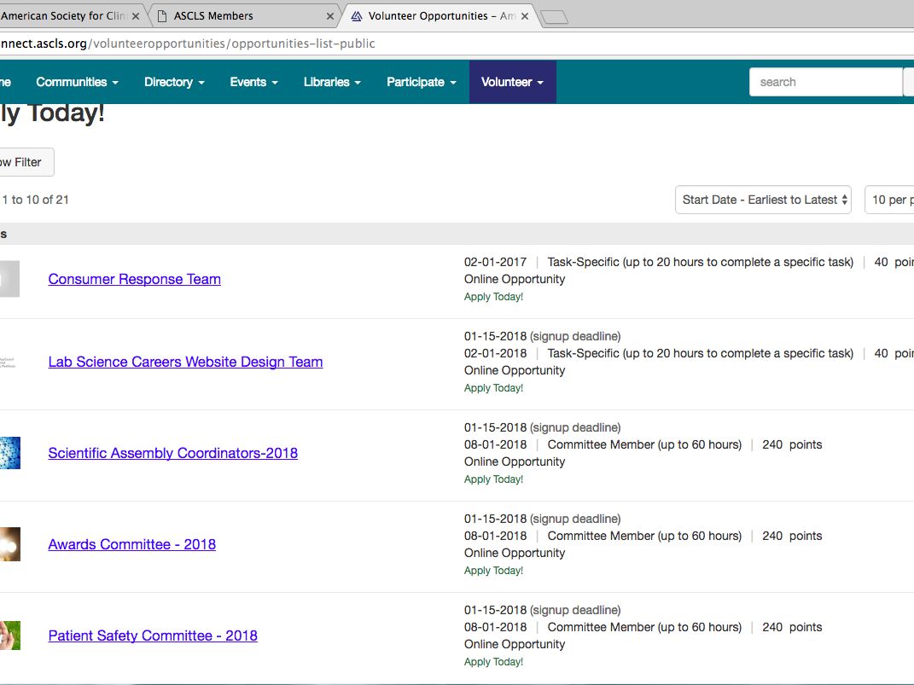

Slide 5
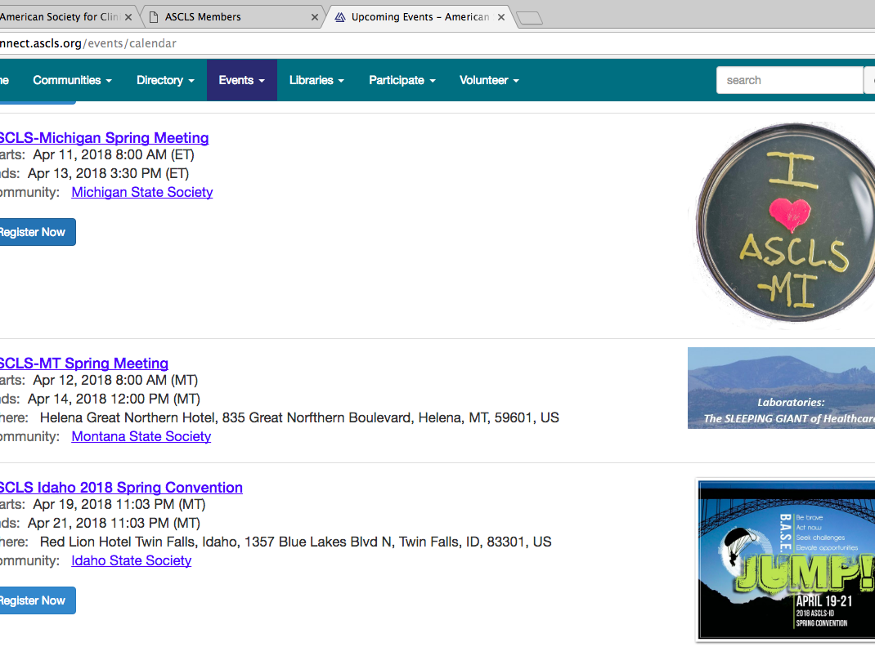

Slide 6
